Slide 1
Chapter 9
Association Rule - Leveraging Modern Tools and Big Data for Market Basket and Beyond
Teh Ying Wah tehyw@um.edu.my University of Malaya

Slide 2

Course Outline
Introduction to Association rule mining
Key Concepts of Association rule mining
Process of association rule mining
Common Algorithm of association rule mining
History of association rule mining
Apriori algorithm using a simple illustrative example
Step-by-Step Execution of Apriori Algorithm
Using the Association Node in Enterprise Miner
Recent Developments and Technologies in Association Rule Mining

Slide 3

Introduction to Association rule mining
Association rule mining, often simply referred to as association rule learning, is a popular method in data mining that aims to discover interesting relationships or associations between variables in large datasets.
It is particularly well-suited for analysing transaction data, such as the items purchased together in shopping carts, to discover patterns of co-occurrence.

Slide 4

Current Examples of Association Rule Mining Applications
Streaming Data Analysis in IoT Devices:
association rule mining can be applied to streaming data from IoT devices, such as in smart homes or manufacturing facilities. For example, smart home systems may analyse streaming data from sensors to identify associations between temperature settings, time of day, and energy consumption.
This allows the system to recommend optimized settings for energy efficiency or predict potential device failures in manufacturing.

Slide 5
Key Concepts
Itemset: A collection of one or more items. For instance, in the context of a supermarket, an itemset might be {Milk, Bread} indicating that both milk and bread are bought together.
Support: This is a measure of how frequently an itemset appears in the dataset. For example, if out of 100 transactions, 10 transactions contain the itemset {Milk, Bread}, the support for this itemset is

Slide 6
Key Concepts
Confidence: This is a measure of the likelihood of item Y being purchased when item X is purchased. It is defined as:
For example, if the support of {Milk, Bread} is 0.1 and the support of {Milk} is 0.5, the confidence of the rule
This means that 20% of the transactions that have milk also have bread.

Slide 7
Key Concepts
Lift: This is a measure of how much more likely item Y is purchased when item X is purchased, compared to when item Y is purchased without regard to item X:
A lift value greater than 1 indicates that items X and Y are more likely to be bought together than just by chance.

Slide 8

Process of association rule mining
The typical process of association rule mining can be broken down into two main steps:
Frequent Itemset Generation: Identify all itemsets that satisfy a minimum support threshold.
Rule Generation: Generate association rules from these frequent itemsets that satisfy a minimum confidence threshold.

Slide 9

Common Algorithm of association rule mining
The Apriori algorithm is one of the most widely known algorithms used for association rule mining. It employs a bottom-up approach where frequent subsets are extended one item at a time (a step known as candidate generation), and groups of candidates are tested against the dataset.

Slide 10

Modern Algorithms of association rule mining
Apriori: Small to medium datasets, Low efficiency due to multiple scans, High memory usage, Not scalable, Use in educational examples.
FP-Growth: Medium to large datasets, High efficiency due to FP-tree, Lower memory requirements, Limited scalability (without distribution), Use in e-commerce analysis.
Spark MLlib (FP-Growth): Very large datasets, Highly efficient and distributed, Memory efficient due to cluster usage, Fully scalable, Use in big data environments like streaming analytics.

Slide 11

Application of association rule mining
The most notable application of association rule mining is in market basket analysis, where retailers can discover patterns of products frequently bought together. This can lead to insights for product placements, promotions, or even new product bundles.
In addition to retail, association rules can be applied in various other domains like healthcare (for adverse drug reactions), finance (for fraud detection), and many more.
recent domains like cybersecurity, recommender systems, and predictive maintenance.

Slide 12
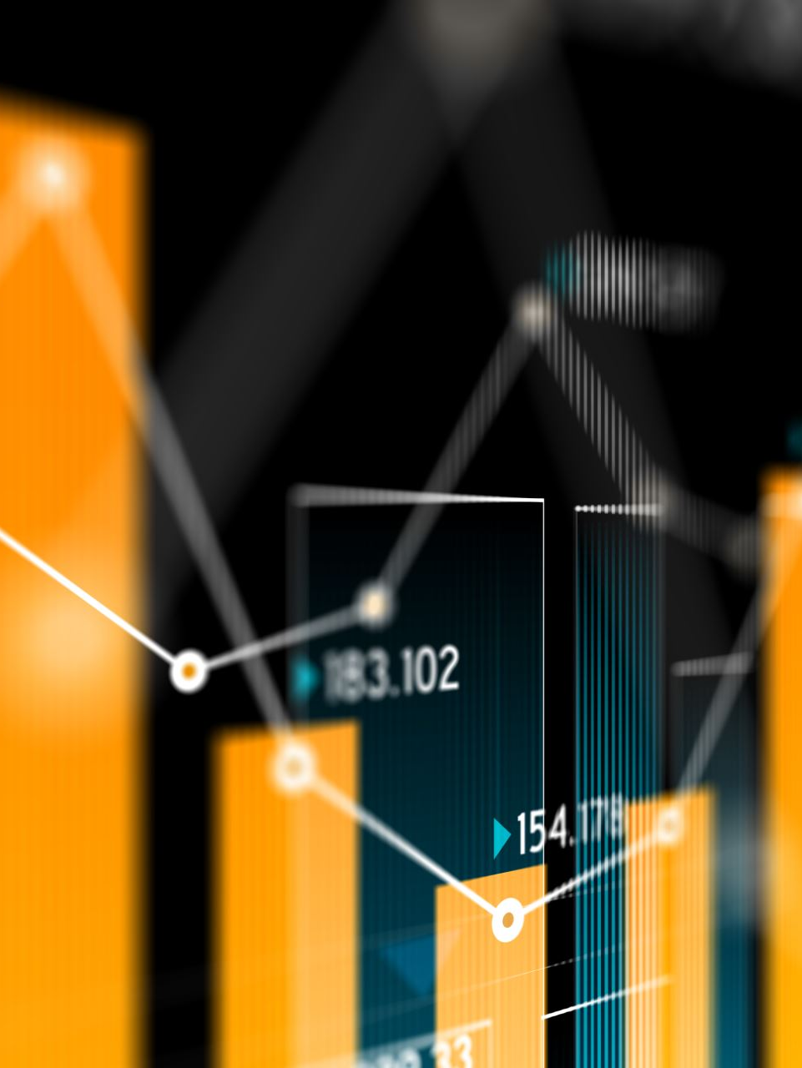
History of association rule mining
1. Early Days of Data Mining (Late 1980s to Early 1990s)
During the late 1980s and early 1990s, the field of data mining began to emerge as databases grew in size and complexity. Researchers sought methods to extract meaningful patterns and insights from vast amounts of data.
2. Introduction of the Apriori Algorithm (1993)
The seminal work on association rule mining is the paper titled "Mining Association Rules between Sets of Items in Large Databases" by Rakesh Agrawal, Tomasz Imieliński, and Arun Swami in 1993. This was presented at the ACM SIGMOD conference.
In this work, the authors introduced the concept of mining association rules from transaction data and proposed the Apriori algorithm. The algorithm was designed to efficiently discover the most frequent combinations of items in transactional databases.
The Apriori algorithm's introduction spurred interest in the field, leading to numerous research initiatives aimed at optimizing and extending the algorithm.

Slide 13

History of association rule mining
3. Extensions and Improvements (Mid to Late 1990s)
Following the introduction of the Apriori algorithm, several variations and improvements were proposed to make the algorithm faster and more memory-efficient.
Algorithms like FP-growth (Frequent Pattern growth) were developed, which eliminated the need for candidate generation, one of the bottlenecks in the Apriori approach.
Other research focused on mining association rules in more complex data types, such as time-series data, spatial data, and multi-relational databases.
4. Applications Beyond Market Basket Analysis (2000s)
As the concept matured, the application of association rule mining extended beyond retail and market basket analysis. It started to be applied in various domains like biology (for gene pattern discovery), web usage mining (to understand user behavior), and healthcare (to find patterns in patient data).

Slide 14

History of association rule mining
5. Integration with Big Data Technologies (2010s and Beyond)
With the advent of big data technologies and platforms like Hadoop and Spark, association rule mining algorithms were scaled to handle even larger datasets.
Distributed versions of association rule mining algorithms were developed to leverage the parallel processing capabilities of these platforms.
6. Current Trends
Today, association rule mining continues to be a valuable tool in the data scientist's toolkit. With the increasing availability of data, there's a renewed interest in extracting meaningful patterns using association rules.
Current research in the area focuses on real-time association rule mining, mining from streaming data, and integrating other machine learning techniques with association rules for more insightful analyses.
The history of association rule mining showcases its evolution from a novel concept for understanding transaction data to a versatile tool used across various domains. It also mirrors the broader trajectory of data mining and analytics, from handling relatively small datasets to today's big data challenges.

Slide 15

Apriori algorithm using a simple illustrative example
Dataset: Transactions at a Grocery Store
Suppose we have the following transactions:
{Milk, Bread, Butter}
{Milk, Bread}
{Milk, Coke}
{Bread, Coke}
{Bread, Butter}
Let's find the frequent itemsets and association rules with Support >= 0.6 and Confidence >= 0.6.

Slide 16
Step-by-Step Execution of Apriori Algorithm
1. Initialization:
List all items and calculate their support.
Support(Milk) = 3/5 = 0.6
Support(Bread) = 4/5 = 0.8
Support(Butter) = 2/5 = 0.4
Support(Coke) = 2/5 = 0.4
Based on our threshold (Support >= 0.6) , we drop items Butter and Coke.

Slide 17
Step-by-Step Execution of Apriori Algorithm
2. Generate Size-2 Candidate Itemsets:
Now, we form pairs of the remaining items.
Since "Milk" and "Bread" are the items that meet the support threshold, our pairs should be:
{Milk, Bread}
The other pairs involving "Butter" or "Coke" should not be generated in the first place.

Slide 18
Step-by-Step Execution of Apriori Algorithm
3. Compute Support for Size-2 Itemsets:
Support(Milk, Bread) = 2/5 = 0.4
Since the support is below our threshold of 0.6, we don't consider this itemset as frequent.
Rule: If Milk, then Bread.
Confidence = Support(Milk, Bread) / Support(Milk) = 0.4 / 0.6 = 0.67
With the updated threshold, 0.67 ≥0.6. Hence, this rule is accepted.
Rule: If Bread, then Milk.
Confidence = Support(Milk, Bread) / Support(Bread) = 0.4 / 0.8 = 0.5
Since 0.5 is less than 0.6, we discard this rule.
Conclusion:
If someone buys Milk, there's a 67% chance they'll also buy Bread.
This provides valuable insights for potential marketing strategies, like placing milk and bread closer in a store or bundling them in a promotional offer.

Slide 19
Using the Association Node in Enterprise Miner
1. Start a New Project and Diagram:
Open Enterprise Miner and start a new project and diagram. Make sure your data is imported and ready for analysis.
2. Data Source Node:
Drag a "Data Source" node onto the diagram workspace and connect your dataset to this node. Ensure your data is properly formatted with transactional data ready for association analysis.
3. Data Preparation:
Input Data Node: If necessary, use the "Input Data" node to specify which variables in your dataset represent items or transactions.
Filtering: If you want to work on a subset of your data or exclude certain transactions, use the "Filter" node.

Slide 20
Using the Association Node in Enterprise Miner
4. Add the Association Node:
From the toolbar or node menu, drag and drop the "Association" node onto the diagram workspace. Connect it to your data source or the last node in your flow if you've done some preprocessing.
5. Configure the Association Node:
Double-click on the Association node to open its properties:
Minimum Support: Set the minimum support threshold (e.g., 0.05 for 5%).
Minimum Confidence: Set the minimum confidence threshold (e.g., 0.8 for 80%).
Maximum Itemsets: Define the maximum number of items in a rule if you want to limit it.
There are other advanced settings available, but for starters, these primary settings will suffice.

Slide 21
Using the Association Node in Enterprise Miner
6. Run the Association Node:
Right-click the Association node and select "Run." Enterprise Miner will execute the node, generating association rules based on the parameters you set.
7. View Results:
Once the node has run successfully, you can double-click on it to view the results:
Rules: A list of association rules with their support, confidence, and lift values.
Item Frequencies: How often each item appears in the dataset.
Rule Antecedents and Consequents: The breakdown of the left and right side of each rule.

Slide 22
Using the Association Node in Enterprise Miner
8. Post-Processing:
Filtering: Use the post-run filtering options to refine the rules you're viewing, based on metrics like lift, support, or confidence.
Export: If needed, you can export the rules to other formats or tools for further analysis or sharing.
Conclusion:
The Association Node in SAS Enterprise Miner makes it relatively easy to conduct association rule mining without delving deep into the algorithmic details. This allows analysts and business users to quickly derive insights from transactional data and make informed decisions.

Slide 23

Modern Technologies in Use
Cloud-Based Platforms: AWS, Azure, Google Cloud examples.
Real-Time Processing: Kafka for streaming data.
For example, in e-commerce platforms, real-time processing allows tracking customer behavior and generating new association rules instantaneously to make real-time product recommendations, such as suggesting items to a customer while they are still shopping.
Integration with Big Data: Apache Spark’s MLlib.

Slide 24
Research Directions and Future Trends
privacy-preserving data mining
real-time association rule generation and its importance in streaming analytic
AI Integration: machine learning models enhance association rule discovery by optimizing rule relevance.

